Slide 1
TURKEY
Legislation and National Policies
Older Persons and Development
Enhancing Health and Well-Being in Old Age
Secured, Facilitating and Supportive Environments
Reflections
Autonomy and Independence
Panelist: Ms. Güher Can VURAL

Slide 2
Situation in European Region
Notes:
The results of the report on abuse of the elderly in the European Region published by the World Health Organization in June 2011 are quite dreadful.

Slide 3
TURKEY
The research indicates that most of the incidents of elderly abuse in Turkey are manifested in violence or exploitation as a result of financial difficulties.

Slide 4
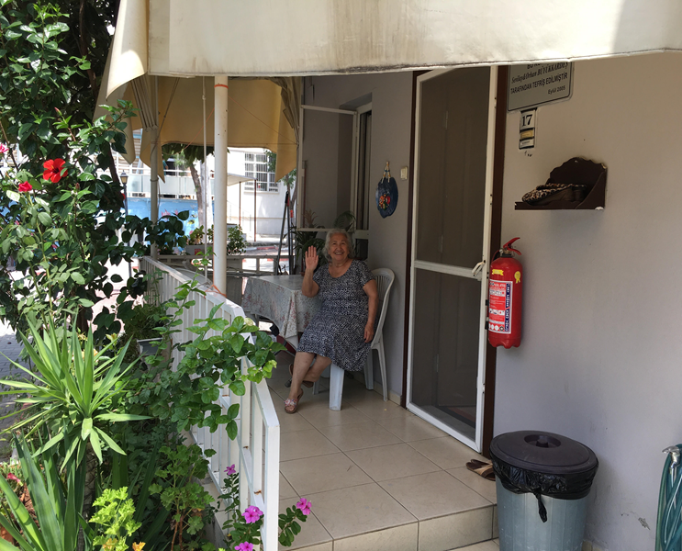
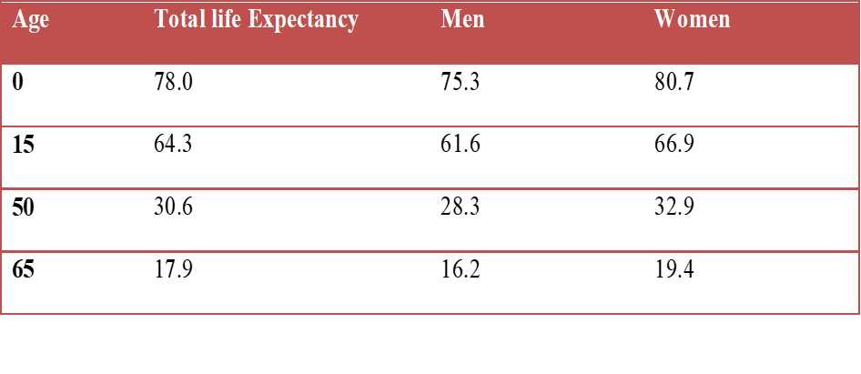
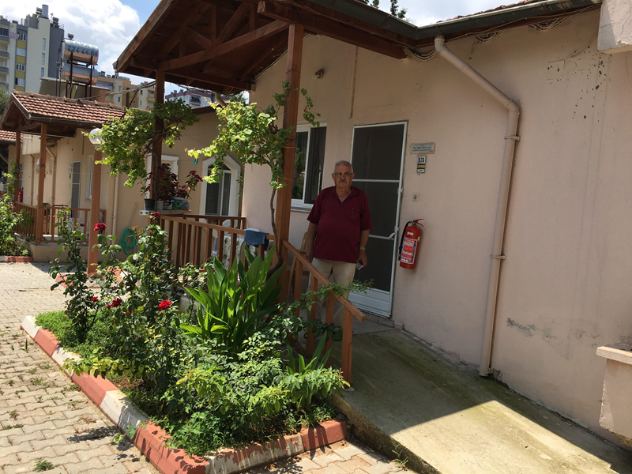
TURKEY
Notes:
Average life expectancy for persons aged 65 is found to be 17.9. This period is 16.2 years for men and 19.4 years for women.

Slide 5
Legal and Policy Framework
ARTICLE 10 – «All individuals are equal without any discrimination before the law, irrespective of language, race, colour, sex, political opinion, philosophical belief, religion and sect, or any such considerations.»
«(Added provision: Art. 1 of Law No 5982 of 7.5.2010) Measures favoring children, the elderly, the disabled, widows and orphans of martyrs and veterans shall not violate the principle of equality.»

Slide 6
Legislation and National Policies on Older Persons
In Turkey, General Directorate of Services for Persons with Disabilities and the Elderly that is the Government Coordinating Body have the task of preparing legislation on elderly services.
The Turkish Constitution includes various provisions about older persons.
There are also regulations on protecting older persons so that positive discrimination measures cover older persons.
Notes:
1. Government Structures, Legislation and National Policies on Older Persons
• Government Coordinating Body or Committee on Older Persons
• Overarching Legislation on Older Persons
• Gender/Disability Provisions in Legislation on Older Persons
• National Policies and Action Plans on Older Persons
• Budgetary Allocation on Older Persons Policies and Programs
• MIPAA Implementation and 2017 Review Preparation

Slide 7
Legislation and National Policies on Older Persons
Active social policy is preferred in Turkey. We adapt new policies according to active policy concept.
Instead of public administration-based service provision; arrangements based on the protection of the elderly, uniform service provision for seniors, ıntensive structure of aged society excluded from society; delivering service with local government, private sector and voluntary organization‘s collaboration, social responsibility development, regulations for investment in individual capacity, delivering elderly services in line with needs, social environment and preferences are deemed appropriate.
Notes:
1. Government Structures, Legislation and National Policies on Older Persons
• Government Coordinating Body or Committee on Older Persons
• Overarching Legislation on Older Persons
• Gender/Disability Provisions in Legislation on Older Persons
• National Policies and Action Plans on Older Persons
• Budgetary Allocation on Older Persons Policies and Programs
• MIPAA Implementation and 2017 Review Preparation

Slide 8
Legislation and National Policies on Older Persons
Firstly, legistation process should include the participation of older persons.
Turkey prepared «National Plan of Action and Implementation Program on Ageing and the Situation of the Elderly» based on the principles of MIPAA in 2013.
Main topics are Age and Development, Increasing Health and Wellbeing of Older Persons, Providing Supportive Environments to Older Persons.
Notes:
1. Government Structures, Legislation and National Policies on Older Persons
• Government Coordinating Body or Committee on Older Persons
• Overarching Legislation on Older Persons
• Gender/Disability Provisions in Legislation on Older Persons
• National Policies and Action Plans on Older Persons
• Budgetary Allocation on Older Persons Policies and Programs
• MIPAA Implementation and 2017 Review Preparation

Slide 9
Older Persons and Development
Key Action: Active Participation in the Society and the Development Process
Objective: Ensuring inclusion of the older persons to all stages of decision-making processes.
• “Boards of Alderman” will be established at provinces, districts or villages and participation of women to these boards will be promoted.
Notes:
2. Older Persons and Development
• Participation of Older Persons in Decision-making and Policy-formulation
• Social Protection of Older Persons – Contributory Pension Schemes
• Non-Contributory Pension and Social Assistance Schemes
• Measures to Increase Employment Opportunities of Older Persons
• Addressing Needs of Older Persons in Humanitarian and Disaster Relief Programs
• Collection of Statistical Data

Slide 10
Older Persons and Development
Key Action: Employment and Ageing Workforce
Target: Employment Opportunities for All Elderly People Who Wish to Work
• Supporting of elderly people who work in the agricultural sector through teaching of new agricultural techniques and technologies and sustaining of access to structural and financial services,
• New arrangements will be made in the working life (gradual transition to retirement and flexible working hours) with respect to encourage older people who can work and want to work.
Notes:
2. Older Persons and Development
• Participation of Older Persons in Decision-making and Policy-formulation
• Social Protection of Older Persons – Contributory Pension Schemes
• Non-Contributory Pension and Social Assistance Schemes
• Measures to Increase Employment Opportunities of Older Persons
• Addressing Needs of Older Persons in Humanitarian and Disaster Relief Programs
• Collection of Statistical Data

Slide 11
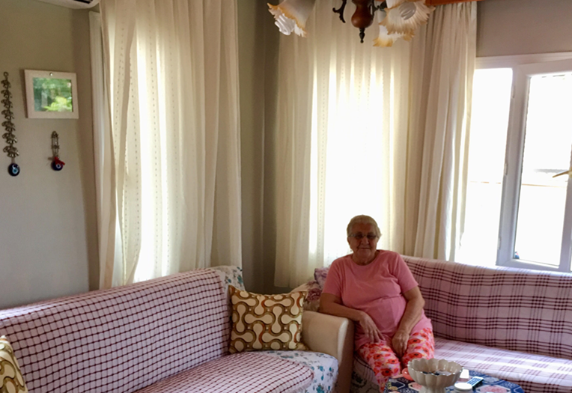
Older Persons and Development
Study of Field: Elimination of Poverty
Target: Elimination of Poverty
• The amount of payments made to elderly persons other than institutional care services within the scope of Law No: 2022 will be increased.
Notes:
2. Older Persons and Development
• Participation of Older Persons in Decision-making and Policy-formulation
• Social Protection of Older Persons – Contributory Pension Schemes
• Non-Contributory Pension and Social Assistance Schemes
• Measures to Increase Employment Opportunities of Older Persons
• Addressing Needs of Older Persons in Humanitarian and Disaster Relief Programs
• Collection of Statistical Data

Slide 12
Advancing Health and Well-Being into Old Age
Objective 1: Decreasing the Cumulative Effects of Risk Increasing Factors for Diseases and Dependence
• With the purpose of improving and developing health at old age, regular health checks will be made at home on demand and transportation to hospitals will be made without any charges.
• A database will be created on ageing and elderly persons in order to plan and implement all services aimed at elderly persons affectively. The concerned database will be designed to include gender specific data and gender sensitive indicators.
Notes:
3. Advancing Health and Well-Being into Old Age
• Policies and Programmes on Healthy/Active Ageing
• Health Insurance Scheme for Older Persons
• Affordable access to primary and secondary health care
• Geriatric and Gerontological Training
• Long term Care
• Measures to Enhance the Mental Health Services for Older Persons
• Measures to Support Persons with Disabilities and Ensure Their Participation in Decision-Making
• Collection of Statistical Data

Slide 13
Advancing Health and Well-Being into Old Age
• The model of home care service for elderly persons will be defined, standards of service provision will be established and home care services will be expanded.
• Emergency call centers will be set up in order to provide emergency services to elderly persons living at their own home. The system will be designed to operate through electronic assistance equipment.

Slide 14
Advancing Health and Well-Being into Old Age
Goal 2: Developing Policies to Prevent Old Age Diseases
• Cities will be rendered «senior friendly". (accessible cities for all - including elderly people, disabled people etc.)
• Programmes will be developed on active ageing, prevention and protection from chronic diseases, effects of diseases and elimination of dependency. All policies and activities on this issue will take into account the differences springing from social and biological gender distinctions.

Slide 15
Advancing Health and Well-Being into Old Age
Goal 3: Provision of Access to Alimentary Products and Adequate Nutrition for All Elderly Persons
• Promoting an adequate and balanced diet for elderly people, preferably consisting of the food products of the area, providing the required level of energy and not causing insufficiency for micro or macro alimentary products, and conforming to the national nutrition goals.

Slide 16
Ensuring Enabling and Supportive Environments
Area: Dwellings and Living Places
Goal 1: Encouraging individuals to “aging in their own environments” within the society, also taking into consideration their personal preferences.
Legislation arrangements will be made with the purpose of ensuring that physical conditions of dwellings are designed to facilitate daily lives of elderly persons.
Notes:
4. Ensuring Enabling and Supportive Environments
• Age-friendly, Affordable Living and Transportation
• Trainings and Accreditation System for Caregivers
• Care Quality Standards, Monitoring Mechanisms and Support to Family Caregivers
• Measures to Address Neglect, Violence, Abuse and Recognise Contributions of Older Persons
• Collection of Statistical Data

Slide 17
Ensuring Enabling and Supportive Environments
Area: Dwellings and Living Places
- Economically deprived elderly persons will be given the opportunity to live in affordable social dwellings
Goal 2: Lifelong sustainability of functional capabilities at optimum level and ensuring full participation of disabled elderly people
Physical and environmental conditions of dwellings will be improved in order to facilitate daily lives and security of elderly persons.
Notes:
4. Ensuring Enabling and Supportive Environments
• Age-friendly, Affordable Living and Transportation
• Trainings and Accreditation System for Caregivers
• Care Quality Standards, Monitoring Mechanisms and Support to Family Caregivers
• Measures to Address Neglect, Violence, Abuse and Recognise Contributions of Older Persons
• Collection of Statistical Data

Slide 18
Ensuring Enabling and Supportive Environments
Area: Dwellings and Living Places
Field: Training of Health Care Providers and Health Care Personnel
Goal 1: Ensuring Sustainability of Services Offered to Elderly People and Supporting Care Providers
• Supporting family members providing home-based care for elderly people on social, psychological and economic terms and providing them educational and consultancy services,
• Improving the integration of healthcare and nursing services, education and palliative treatment standards, and supporting multidisciplinary approaches to all palliative treatment service providers, establishing special centers for palliative care in hospitals.
Notes:
4. Ensuring Enabling and Supportive Environments
• Age-friendly, Affordable Living and Transportation
• Trainings and Accreditation System for Caregivers
• Care Quality Standards, Monitoring Mechanisms and Support to Family Caregivers
• Measures to Address Neglect, Violence, Abuse and Recognise Contributions of Older Persons
• Collection of Statistical Data

Slide 19
Ensuring Enabling and Supportive Environments
Elderly persons with mental health problems, contagious diseases or addiction to drugs, alcohol or tobacco will be provided care services in institutions affiliated with public hospitals.
• Qualified interdisciplinary staff will be employed in the field of ageing (geriatrics, gerontology etc).
• Occupational standards for the staff employed in care services will be prepared and trainings will be held in accordance with these standards. Qualified personnel will be employed for the care of elderly persons at a sufficient number.
Notes:
4. Ensuring Enabling and Supportive Environments
• Age-friendly, Affordable Living and Transportation
• Trainings and Accreditation System for Caregivers
• Care Quality Standards, Monitoring Mechanisms and Support to Family Caregivers
• Measures to Address Neglect, Violence, Abuse and Recognise Contributions of Older Persons
• Collection of Statistical Data

Slide 20
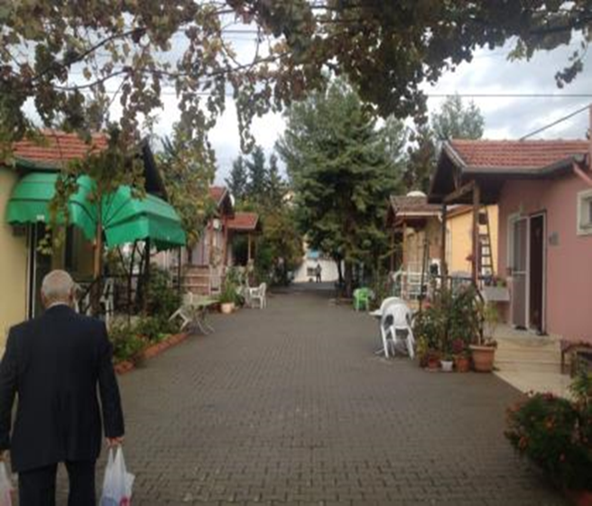
Reflections
The debate on the rights of the elderly in Turkey covers many subheadings including;
-prevention of discrimination against the elderly,
-prevention of violence,
-right to social security,
-right to health,
-right to work, education and lifelong learning,
-right to protection of wealth and legacy.
Notes:
Observations
Concluding remarks

Slide 21
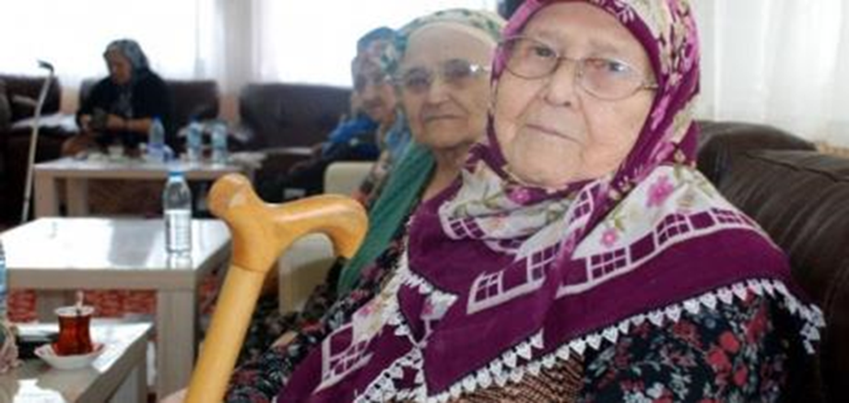
Reflections
In this context, positive action measures are needed to be put in place for the elderly.
Increasing older persons’ awareness about their rights and services.
THANK YOU FOR LISTENING.
Notes:
Observations
Concluding remarks

Slide 22
Ms. Güher Can VURAL
Assistant Labor Social Services and Family Expert
Ministry of Labor Social Services and Family
General Directorate of Services for Persons with Disabilities and Elderly People
Phone:+90 312 705 7059
E-mail: guher.vural@aile.gov.tr

